Slide 1
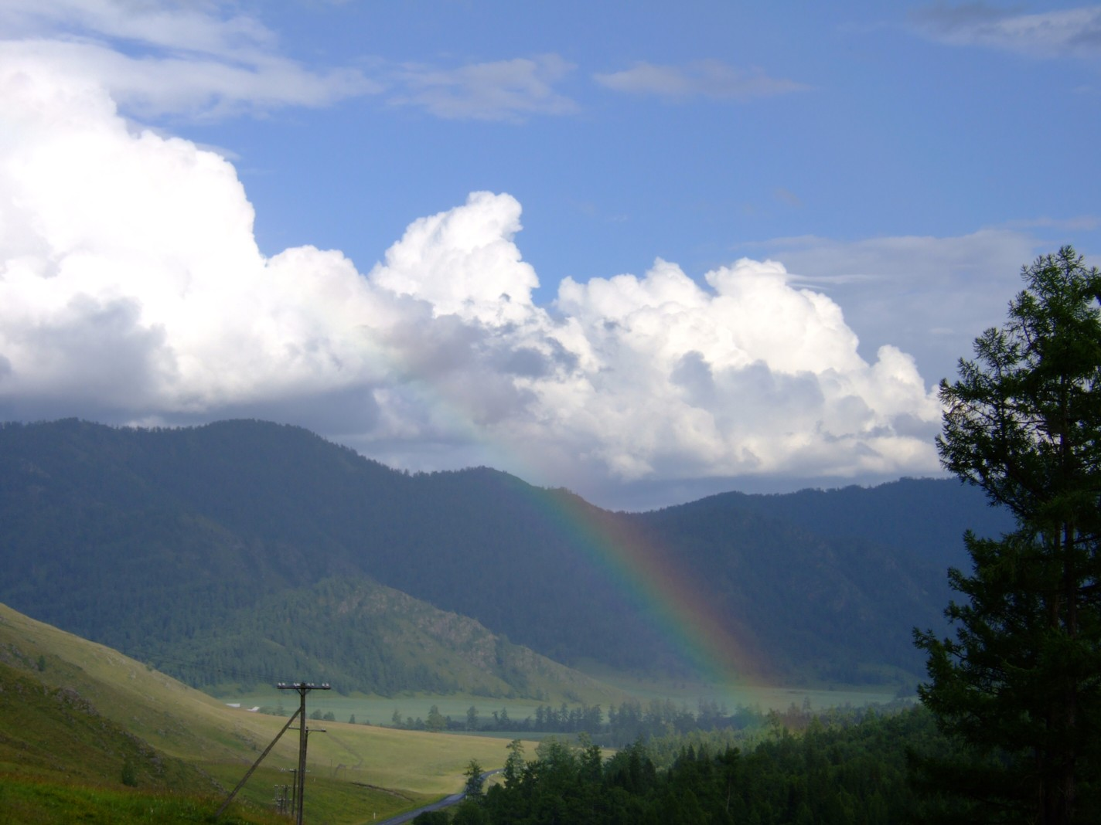
Molecules of Life
By: Oliver-John Bright and Kety Silva

Slide 2
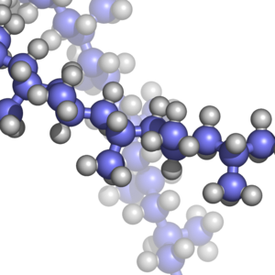
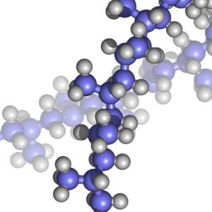
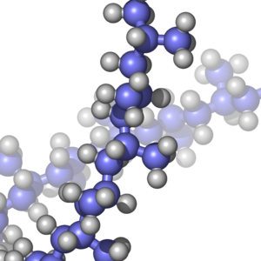
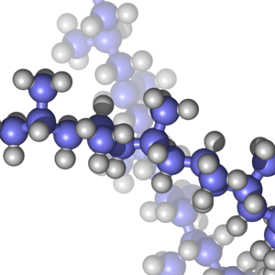
Biological Molecules
The four main classes of biological molecules are carbohydrates, lipids, proteins and nucleic acids.
They are known as macromolecules which are giant molecules formed by the joining of smaller molecules.

Slide 3
Macromolecules
Most macromolecules are polymers built from monomers.
A polymer is a long molecule consisting of many other similar or identical building blocks linked by covalent bonds.
The building blocks of a polymer are called monomers and they can have different functions of their own.

Slide 4
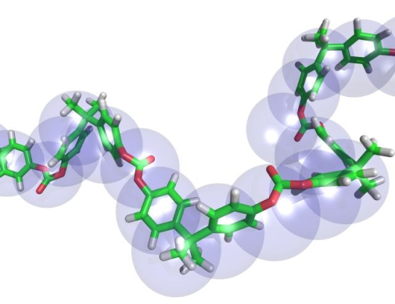

The synthesis and break down of polymers
Monomers are connected covalently together through the loss of a water molecule this process is called a condensation reaction or dehydration reaction.
One monomer contributes a hydroxyl and the other provides a hydrogen, and this process is continues like a chain until the polymer is created. Enzymes are specialized and used to speed up the chemical reactions.
Hydrolysis is the opposite of a condensation reaction an it breaks down the polymers into monomers with the addition of a water molecule.

Slide 5
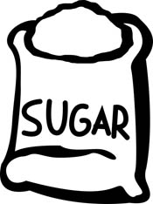

Carbohydrates
Carbohydrates serve as fuel and building material and they are known as both the sugar and the polymer of a sugar.
Disaccharides are double sugars consisting of two monosaccharide joined by a condensation reaction or in other words a glycosidic linkage
  Ex: Maltose, sucrose (table sugar)
Monosaccharide- are the simplest carbohydrate aka simple sugars CH2O
  Glucose is the most common monosaccharide C6H12O6 VERY IMPORTANT

Slide 6
Polysaccharides are macromolecules and polymers with a few hundred or thousands of monosaccharide joined by glycosidic linkages.
Storage Polysaccharides
Starch is an important polysaccharide in plants and it is also found in potatoes, wheat corn, ect.
In animals glycogen is a polysaccharide that is a easy source of energy.
Structural Polysaccharides
Cellulose is a major component of the tough cell walls in plants.
Chitin is another polysaccharides that makes up the tough exoskeleton of many insects and arthropods.

Slide 7

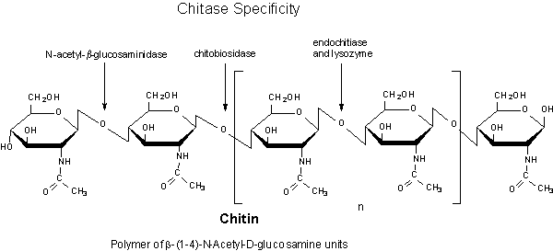
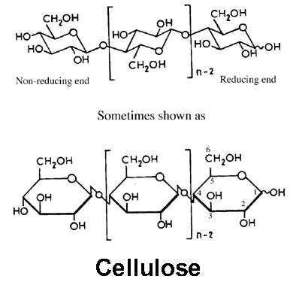
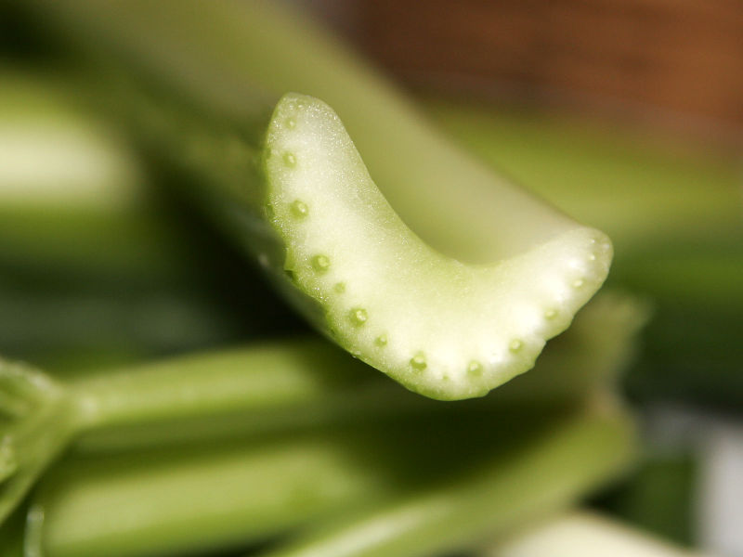
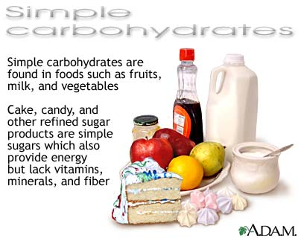
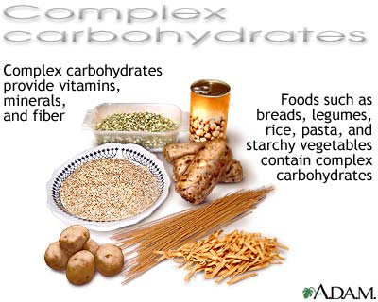
Carbohydrates

Slide 8
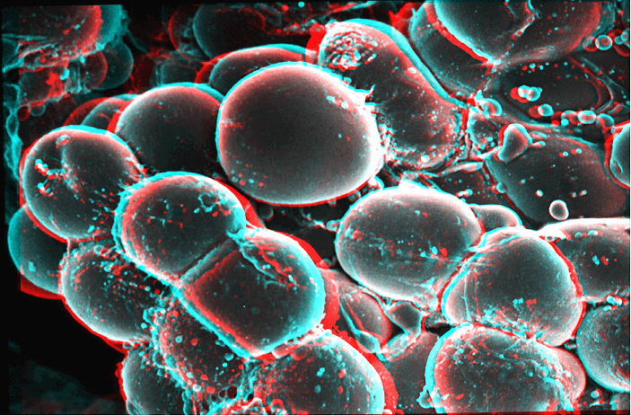
Lipids
A fat is a constructed from two kinds of smaller molecules; a glycerol and fatty acids. This bond is called a esther linkage which is a bond between a hydroxyl group and a carboxyl resulting in a triacylglycerol.
Fats are not polymers but they assemble smaller molecules by dehydration synthesis.

Slide 9
Fats are hydrophobic due to the fact that they are composed of non- polar C-H bonds in the hydrocarbon chains of fatty acids.
An unsaturated fat have kinks where the cis. bonds are located and they prevent the molecules from packing together.
  They are liquid at room temp. “hydronated vegetable oil” means that the unsaturated fats have been turned into saturated with the addition of hydrogen.
    Peanut butter, margarine
A saturated fatty acid does not have any double bonds between the carbon atoms.
  Ex. Butter, lard which are solid at room temp.

Slide 10
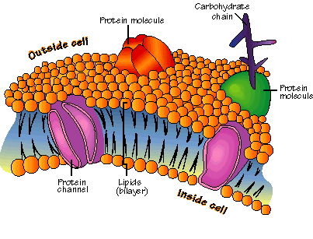
Phospholipids
Phospholipids have two fatty acids attached to a glycerol and the third hydroxyl group of the glycerol is joined to a phosphate group which has a negative charge.
They are composed of a hydrophobic tail and hydrophilic head and when added to water they self-
assemble into bilayers which shields the hydrophobic tails from the water outside of the cell.

Slide 11
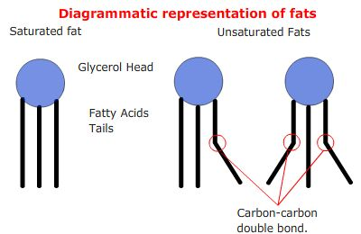
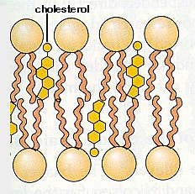
Steroids
Steroids are lipids that contain a carbon skeleton which consist of four fused rings.
Cholesterol is a steroid which is a common component of the cell membranes in animals.
Many hormones such as human sex steroid are produced by cholesterol.
Saturated fats and unsaturated fats play a heavy role on cholesterol levels in humans and too much can lead to health problems.

Slide 12
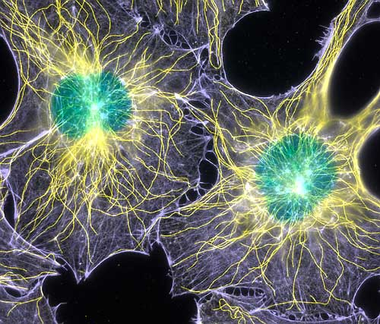
Proteins
Proteins account for about 50% of the dry mass in organisms. Proteins can speed up chemical reactions, they play a role in structural support, storage, transport, cellular communication, movement, and defense against foreign substances.
Enzymatic proteins aid in the selective acceleration of chemical reactions. They are the most important proteins and they regulate metabolism
by acting upon a catalyst speeding up the reaction.
Storage proteins store amino acids

Slide 13
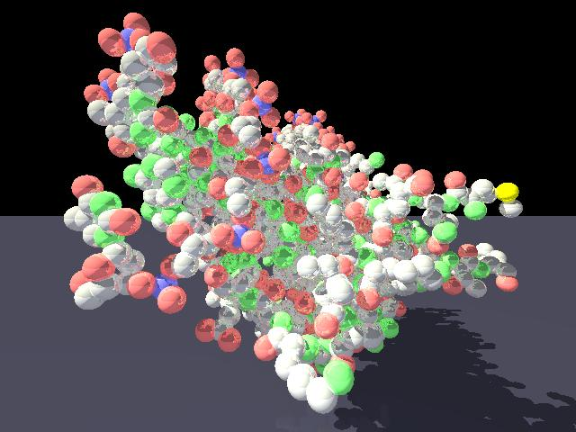
Transport proteins aids in the transport of other substances.
Hormonal proteins coordinate the organisms activities
Receptor proteins respond to the cell’s stimuli
Contractile and motor proteins control the movement in a cell
The defense proteins protect and fight against disease

Slide 14
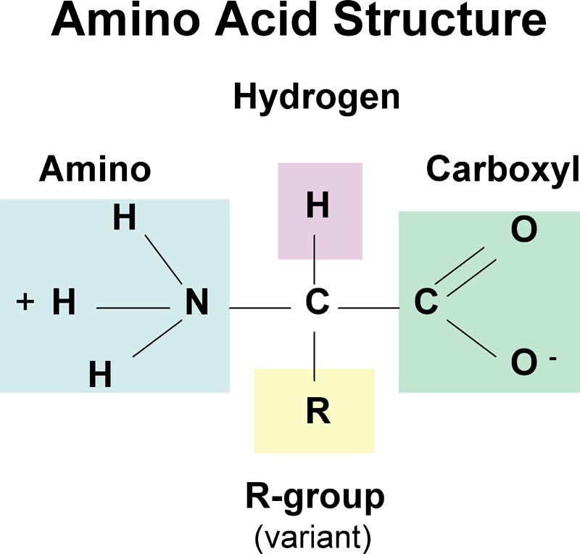
Amino Acids
Amino acids are monomer and they are organic molecules which posses both a carboxyl, amino group, hydrogen atom and the R group side chain.
The side chain determines the unique characteristics of an amino acid and are most found in acidic amino acids.
Amino acids join and form polymers by dehydration reactions and when the carboxyl and the
amino groups are positioned next to each other.

Slide 15
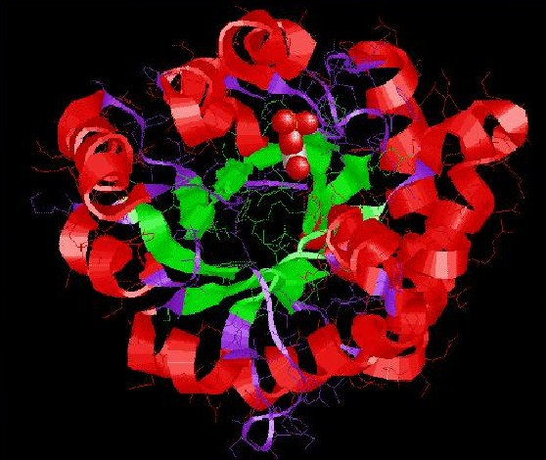
This results in a covalent bond called a peptide bond.
A polypeptide is created when this reaction is completed over and over again.

Slide 16
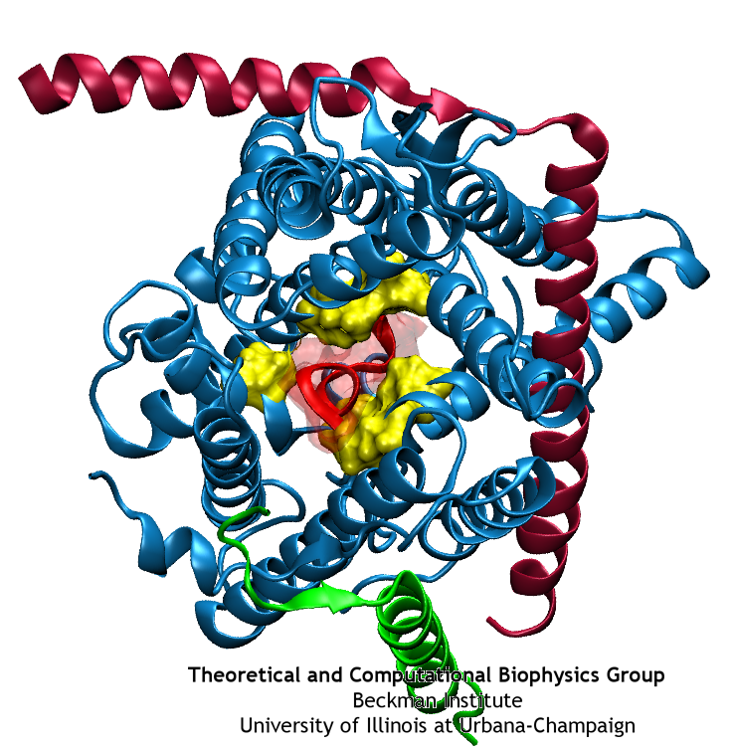
Polypeptides
Polypeptides are the polymers of proteins and a specific protein consist of one or more polypeptide folded and coiled into specific structures.
The amino acids sequences usually determine what three- dimensional shape the protein will take.

Slide 17
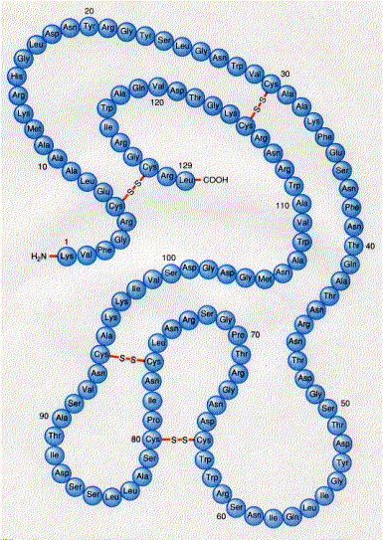
Primary Structure
Is a protein’s unique sequence of amino acids
Ex. Transthyretin is a globular protein that transports vitamin A and a thyroid hormone throughout the body.

Slide 18
Secondary Structure
The coils and folds in a protein’s polypeptide chains are referred to as secondary structure and it is the result of hydrogen bonds between the repeating constituents of the polypeptide backbone.
Individually the hydrogen bonds are weak but together they form a particular shape to the protein.
A helix is a secondary structure and it is a delicate coil held together by hydrogen bonding between every forth amino acid.
A b-pleaded sheet is another type and it makes up the core of many globular proteins.

Slide 19
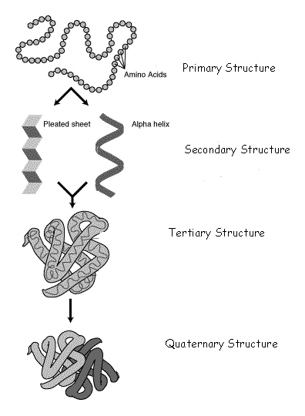

Slide 20
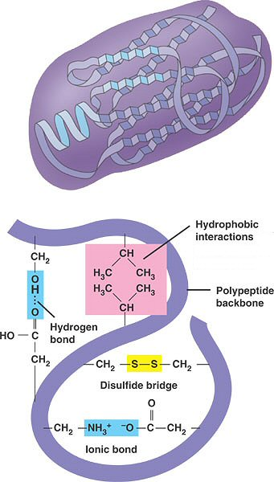
Tertiary Structure
Is the overall shape of the polypeptide resulting from the interactions between the side chains (R groups) of the amino acids
Hydrophobic interactions are when amino acids with the non- polar side chains usually end up clustered at the core of the protein, and out of contact with water and once they are together the interaction keeps they connected.
Disulfide bridges are formed when two cysteine monomers, amino acids with sulfhydryl groups on their side chains, are brought closer by the folding proteins

Slide 21
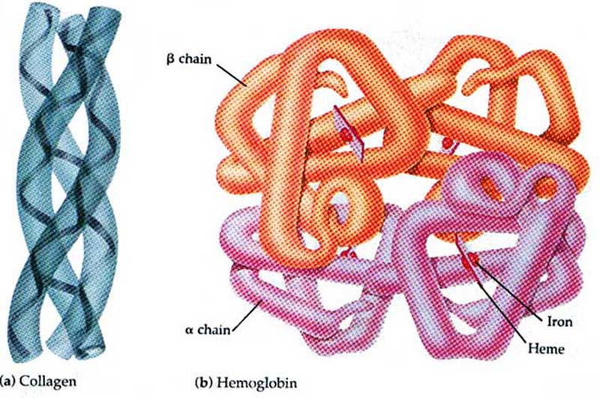
Quaternary Structure
Is the overall protein structure that results from the fusion of polypeptide subunits due to the fact that some proteins consist of two or more polypeptide chains fused into a functional macromolecule.

Slide 22
Nucleic Acids
A gene is a unit of inheritance and they have DNA which is polymer belonging to the class of nucleic acids.
There are two types of Nucleic Acids
  Ribonucleic Acids (RNA)
  Deoxyribonucleic acid (DNA)
  They help living organisms to reproduce and pass on the traits from one generation to the next.
  Nucleic acids are macromolecules that exist as polymers called polynucleotide.
  The monomers are called nucleotides.

Slide 23
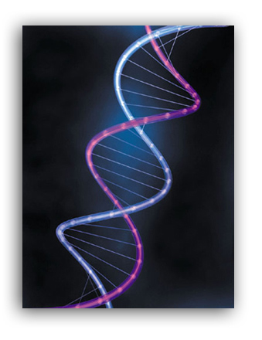
A nucleotide is composed of three parts
  Nitrogenous base
  A pentose sugar
  A phosphate group and without the phosphate group it is a nucleoside
  There are two types of nitrogenous bases known as pyrimidines which has a six- membered rings of carbon and nitrogen.
  The members are Cytosine (C), Thymine (T)
  and Uracil (U)
  The other nitrogenous base are the Purines which are larger with a six- membered fused into a five -member ring
  - The members are Adenosine (A), Guanine (G)

Slide 24
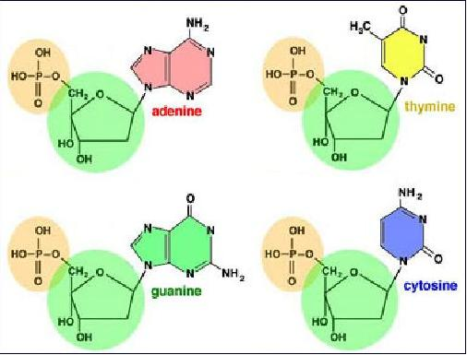
Purines and Pyrimidines are different due to their functional groups(A), (G), (C) are found in all types of nucleic acids but (T) is only found in DNA and (U) is only found in RNA
DNA lacks an oxygen on the second carbon in the ring causing it to be different from RNA.

Slide 25
Nucleotide polymers
Adjacent nucleotides are joined by covalent bonds called phophodiester linkages between the H group and the 3’ carbon of one nucleotide and the phosphate of the 5’ carbon of the next nucleotide.
This then creates a repeating pattern of sugar- phosphate

Slide 26
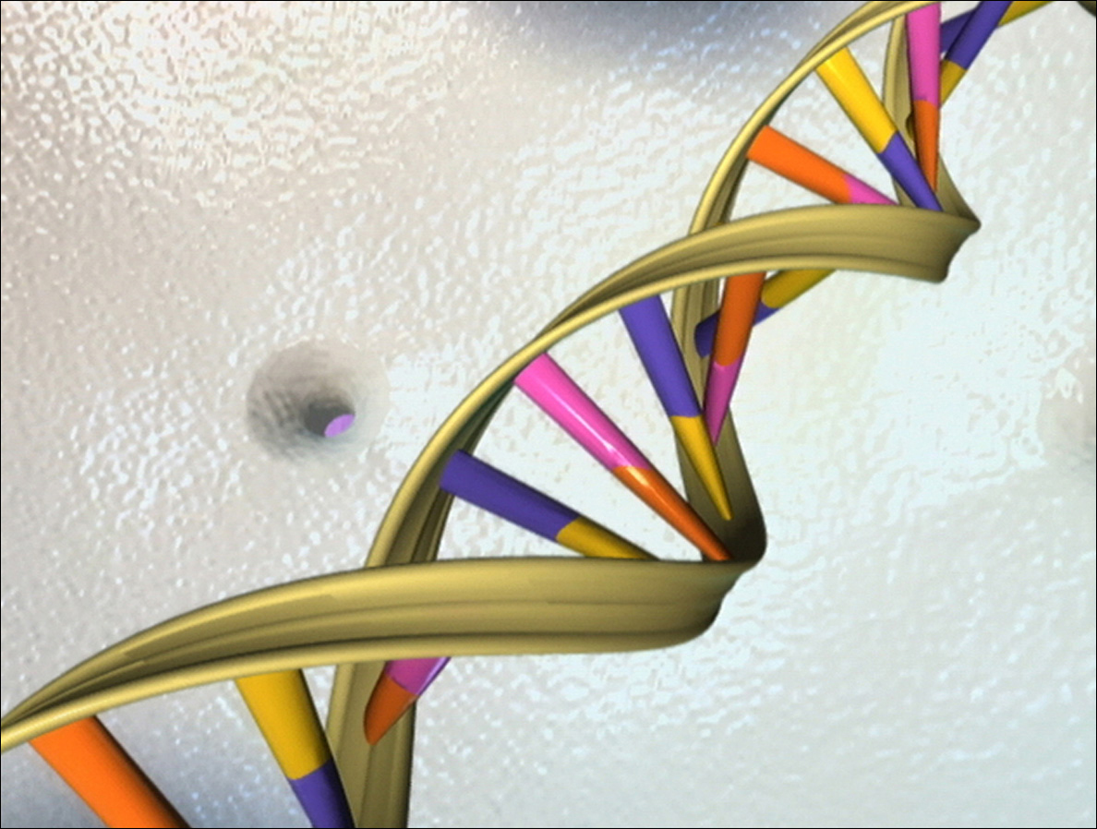
The DNA double helix
RNA consist of a single polynucleotide chain, however DNA molecules have two polynucleotide spirals around an imaginary axis forming a double helix.
In 1953 scientist determined that DNA was a three dimensional structure and the opposite 5’-3’ are referred to as an anti-parallel. The two polynucleotides are held together by hydrogen bonds between the paired bases.

Slide 27
Certain bases connect with each other:
Adenine (A) is paired with Thymine (T) and Guanine (G) is paired with Cytosine (C)
Ex: AGGTCCG
TCCAGGC
This enables DNA to make up the precise copies of the genes.

Slide 28
THE END

Slide 29
Bibliography
Images:
  http://www.thetriplehelix.org/wordpress/wp-content/uploads/2006/11/dna.jpg
  http://www.personal.psu.edu/faculty/r/p/rpm198/evolgen/nucleotides.jpg
  http://www.nlm.nih.gov/medlineplus/ency/images/ency/fullsize/19529.jpg
  http://www.medic.usm.my/~ssu/images/High%20Glyc.jpg

Slide 30
http://kvhs.nbed.nb.ca/gallant/biology/quaternary_structure.jpg
http://kvhs.nbed.nb.ca/gallant/biology/tertiary_structure.jpg
http://content.answers.com/main/content/wp/en/thumb/a/ab/250px-Protein-structure.png

Slide 31
Sources:
  http://antoine.frostburg.edu/cgi-bin/serese/tutorials/isomer/index.cgi
  http://www.wisc-online.com/objects/index_tj.asp?objID=ap/1304
  http://www.hhmi.org/biointeractive/obesity/molfat/index.html
  http://www.biology.arizona.edu/biochemistry/problem_sets/large_molecules_problems.html
  http://academic.pg.cc.md.us/~ssindex/bit/nucleotides/nucleotides.htm
  http://bcs.whfreeman.com/thelifewire/content/chp03/0302002.html

